Slide 1
Trees

Slide 2
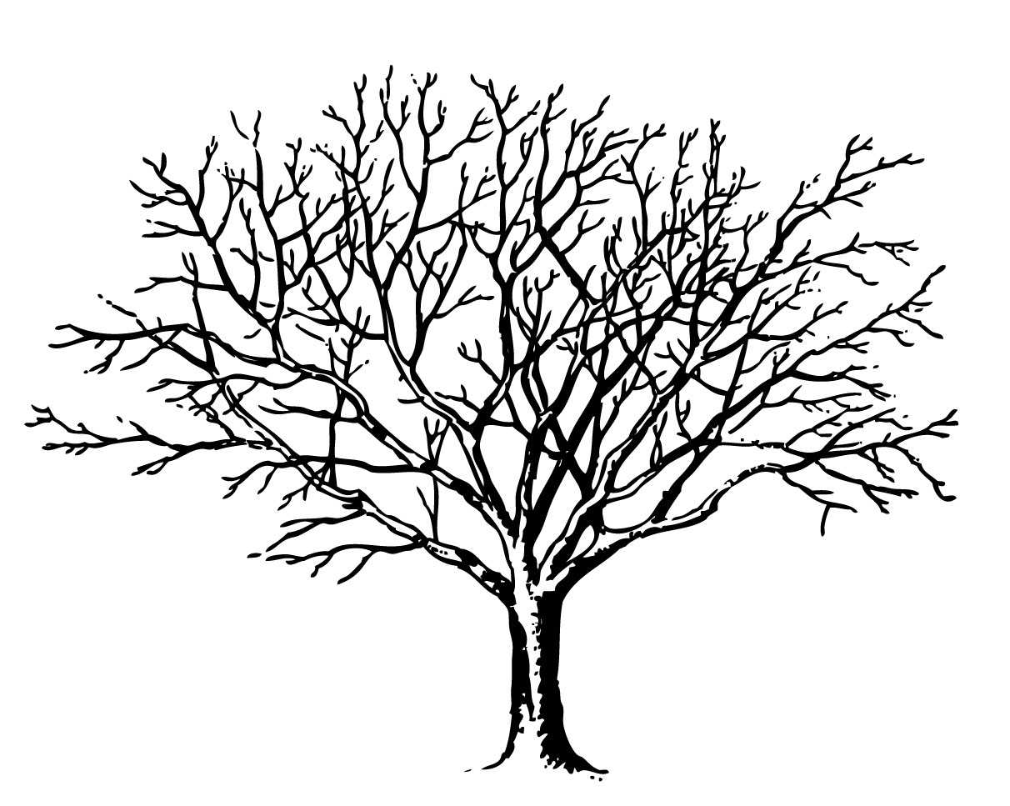

Slide 3
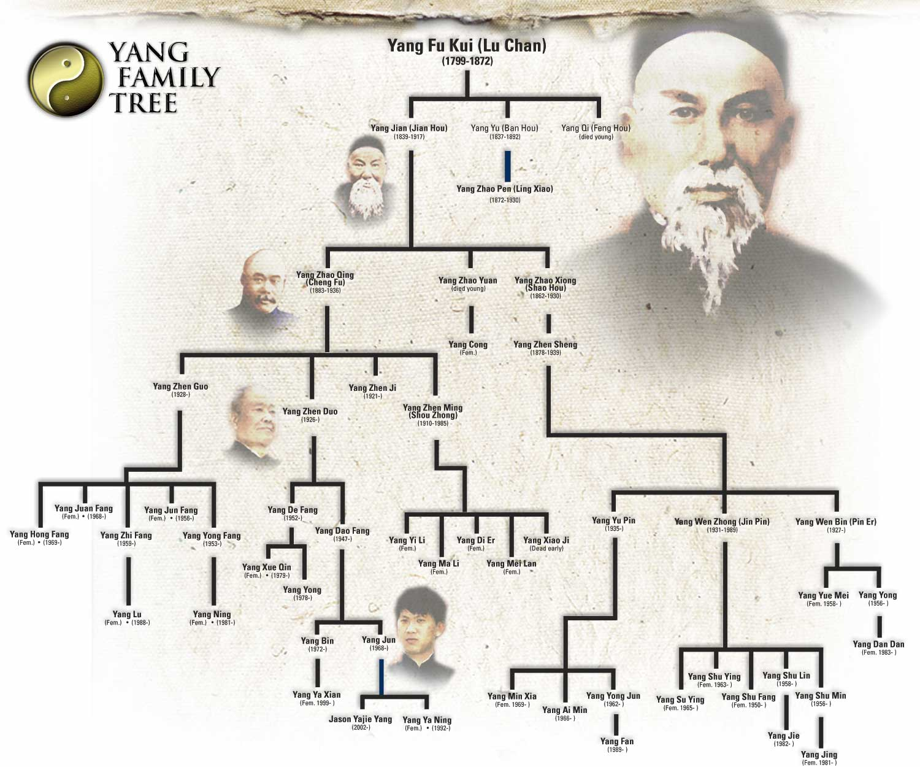

Slide 4
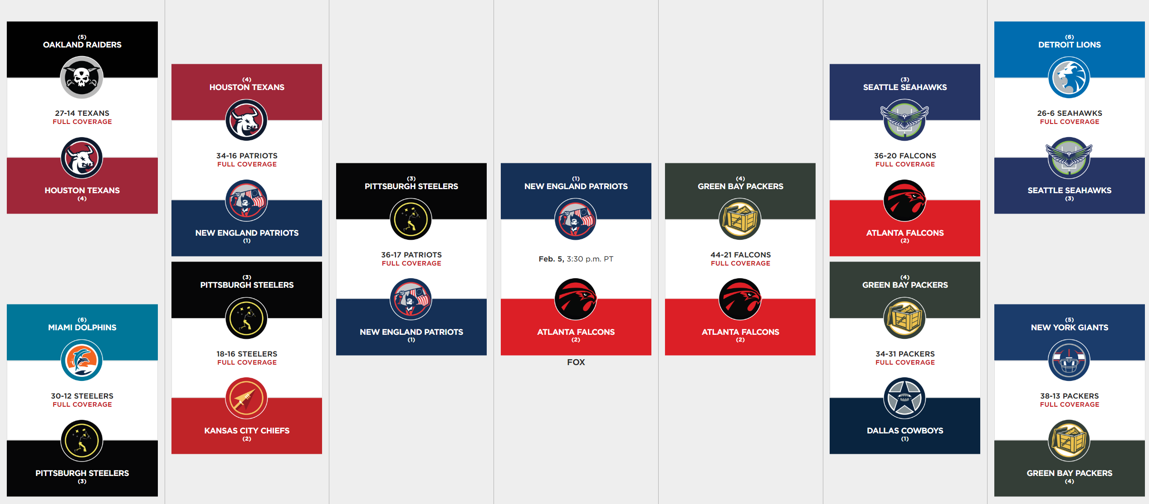

Slide 5
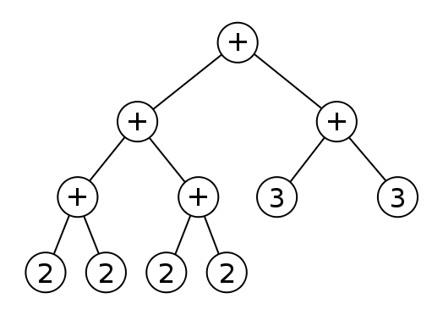

Slide 6
Terms
Root – "top of the tree"

Slide 7
Terms
Child– a node that has a parent

Slide 8
Terms
Internal Node – Has at least one child

Slide 9
Terms
Leaf Node – Has no children

Slide 10
Terms
Edge – Connects two nodes. Unidirectional.

Slide 11
Terms
Path – A series of edges that connect two nodes

Slide 12
Terms
Length – The number of edges in a given path (our example has length of 2)

Slide 13
Terms
Depth – Starting from 0, the level at which a node exists
Depth 0
Depth 1
Depth 2

Slide 14
Terms
Height – The number of levels below a given node. (e.g. root has height 2)

Slide 15
Terms
Subtree – A tree within a tree (note it has it's own root)

Slide 16
Terms
Binary tree – trees whose nodes have at most two children
A
B
C
D
E
F

Slide 17
Terms
Traversal – A method to visit each node in the tree.
A
B
C
D
E
F

Slide 18
Terms
Preorder Traversal – Visiting "us" before visiting our children
A
B
C
D
E
F
A, B, E, C, F, D

Slide 19
Terms
Postorder Traversal – Visiting children before us
A
B
C
D
E
F
E, B, F, C, D, A

Slide 20
Terms
In-order traversal: Visit "Left", then "us", then "right" (works best for binary trees)
A
B
C
D
E
F
D, B, E, A, C, F

Slide 21
What is the pre, in, and post order traversal of the following tree

Slide 22
Terms
Full binary tree – nodes have either 2 or 0 children
A
B
C
D
E
F
(This tree is not full)

Slide 23
Terms
Full binary tree – nodes have either 2 or 0 children
A
B
C
D
E
G
F
This tree is full

Slide 24
Terms
Complete binary tree – All levels in a tree are full with the exception of the last. The last level is filled in from left to right.
A
B
C
D
E
G
F
This tree is complete. It is also full.

Slide 25
Terms
Complete binary tree – All levels in a tree are full with the exception of the last. The last level is filled in from left to right.
A
B
C
D
G
F
This tree is not complete. It is also not full.

Slide 26
Terms
Complete binary tree – All levels in a tree are full with the exception of the last. The last level is filled in from left to right.
A
B
C
D
This tree is complete. It is not full.

Slide 27
Terms
Complete binary tree – All levels in a tree are full with the exception of the last. The last level is filled in from left to right.
A
B
C
G
F
This tree is not complete. However, it is full.

Slide 28
Terms
Complete binary tree – All levels in a tree are full with the exception of the last. The last level is filled in from left to right.
A
B
C
D
E
G
This tree is complete. However, it is not full.

Slide 29
Is this tree complete?
A
B
C
D
G
Yes
No

Slide 30
Is this tree full?
A
B
C
D
G
Yes
No

Slide 31
The in-order traversal of this tree is:
A
B
C
D
G
A, B, C, D, G
A, B, D, C, G
D, B, A, G, C
D, B, G, C, A

Slide 32
Is this tree full?
A
B
C
D
E
G
Yes
No

Slide 33
Is this tree complete?
A
B
C
D
E
G
Yes
No

Slide 34
The pre-order traversal of this tree is:
A
B
C
D
E
G
D, E, B, A, G, C
A, B, C, D, E, G
A, B, D, E, G, C
D, B, E, A, G, C
D, E, B, G, C, A

Slide 35
Is this tree complete?
A
B
C
D
E
Yes
No

Slide 36
Is this tree full?
A
B
C
D
E
Yes
No

Slide 37
The post-order traversal of this tree is:
A
B
C
D
E
D, E, B, C, A
E, D, C, B, A
C, A, E, D, B
A, B, D, E, C
D, B, E, A, C

Slide 38
Is this tree full?
A
B
C
D
E
Yes
No

Slide 39
Is this tree complete?
A
B
C
D
E
Yes
No

Slide 40
The in-order traversal of this tree is:
A
B
C
A, B, C, D, E
B, A, E, D, C
B, A, D, C, E
B, D, E, C, A
D
E

Slide 41
Is this tree complete?
A
B
C
G
H
D
E
Yes
No

Slide 42
Is this tree full?
A
B
C
G
H
D
E
Yes
No

Slide 43
Which of the following isn’t a valid traversal?
A
B
C
G
H
D
E
A, B, G, H, C, D, E
G, B, H, A, D, C, E
G, B, H, D, C, E, A
G, H, B, D, E, C, A

Slide 44
Is this tree full?
A
B
C
F
G
D
E
H
I
Yes
No

Slide 45
Is this tree complete?
A
B
C
F
G
D
E
H
I
Yes
No

Slide 46
The pre-order traversal of this tree is:
A
B
C
F
G
D
E
A, F, B, G, H, I, C, D, E
A, B, C, D, E, F, G, H, I
A, B, F, G, H, I C, D, E
F, B, H, G, I, A, D, C, E
H
I

